Slide 1


First Power BI Report:
Sales Overview
MINI PROJECT
Rowad Misr Initiative · Presented by Data Miners team

Slide 2


Our Team
Ahmed Fakher
Amira Adel
Ali Abdelsalam
Mariam Skoot
Esraa Badr

Slide 3
Agenda
01
02
03
04
Problem Statement
Data Cleaning
Data Modeling
Dashboard & Insights

Slide 4
Problem Statement
Sales data sits in one raw Excel sheet. Management cannot quickly see how the business is performing.
The Data
The Questions
The Goal
104 orders, 48 customers
Feb 2023 to Dec 2024
9 columns, 4 products, 4 regions
How much did we sell?
Which category, product and region lead?
How do sales move month to month?
Clean the raw data
Build a simple model
Deliver one interactive dashboard

Slide 5
Step 1: Data Cleaning by Power Query
Column | Issue | Action
Category_Type | Mixed case: “accessories” vs “Accessories” | Standardized to one format
Order_Date_new | Dates must be real dates for time analysis | Set as Date type
Qty, Unit_Price, Total_Sales | Numbers must be numeric and consistent | Whole-number type; Total = Qty × Price checked
Order_ID, nulls | Duplicates and missing values | None found: IDs unique, no blanks
Zero price / zero qty rows | 8 rows with price 0, 7 with qty ≤ 0 | Reviewed and kept in totals

Slide 6
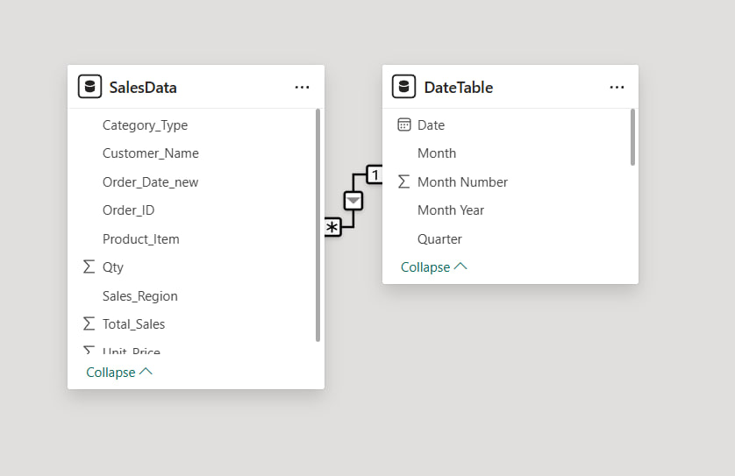
Step 2: Data Modeling & Measures
Sales Table
Date Fields
DAX Measures
Cleaned orders: customer, product, category, region, date, qty, price, total
Year and Month taken from the order date to drive the slicers and the monthly trend
Five KPIs feeding the cards on the dashboard
KPI | Logic | Value
Total Sales | Sum of Total_Sales | $199,277
Total Orders | Distinct count of Order_ID | 104
Total Customers | Distinct count of Customer_Name | 48
Avg Order Value | Total Sales ÷ Total Orders | $1,916
Avg Unit Price | Total Sales ÷ Total Quantity | $388.45
Total Quantity | Sum of Qty | 513

Slide 7
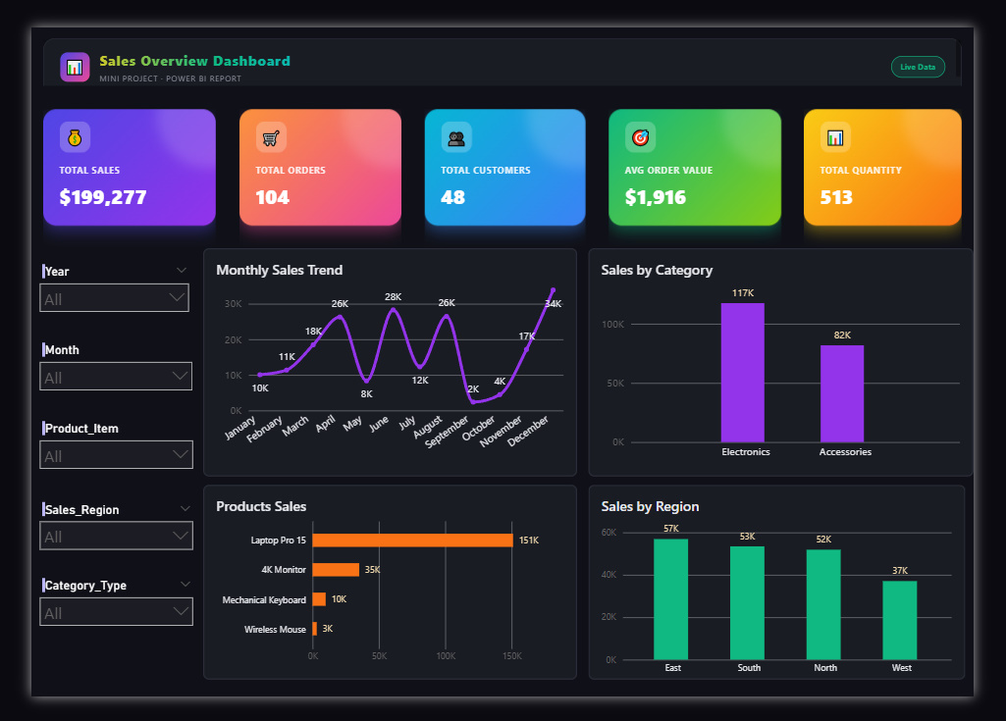
Step 3: The Dashboard
Electronics leads
$117K vs $82K for Accessories
One star product
Laptop Pro 15 brings $151K of $199K
East is top region
$57K, while West trails at $37K
Peak and dip
Highest in December ($34K), lowest in September ($2K)

Slide 8
Thank You
Any questions?

